Slide 1
Ridgecrest Elementary VPK 2020-2021

Slide 2
Vision & Mission
Our Vision: 100% Student Success: every student making one year's growth or more in a school year. Provide the school's vision statement
The mission of Ridgecrest Elementary is to encourage and empower our students in mind, body, and heart to discover and pursue their lifelong goals as productive citizens of our world. School Leadership

Slide 3
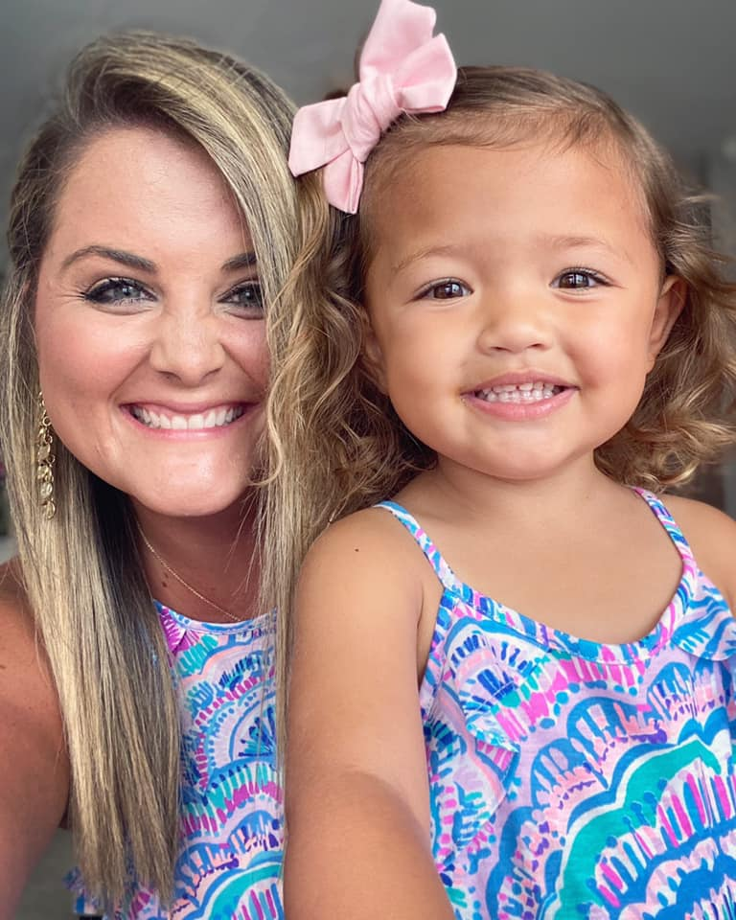
About Me…
HI! I’m Kayla Allen (Ms. Allen) and I am so excited for this school year!
I graduated with my undergraduate degree in Early Childhood Education from the University of Central Florida as well as my Master of Education degree in Exceptional Student Education with a specialty in Autism Spectrum Disorder also from the University of Central Florida. This is my sixth year teaching and I have taught grades pre-k 3 through 3rd grade.
I am a mama to a sweetie pie named Ella Joy (3 years old) and love to do fun things with her! We spend many weekends at the beach, the zoo, Disney, and most importantly with family!
I am looking forward to working together to make this year a great success!

Slide 4
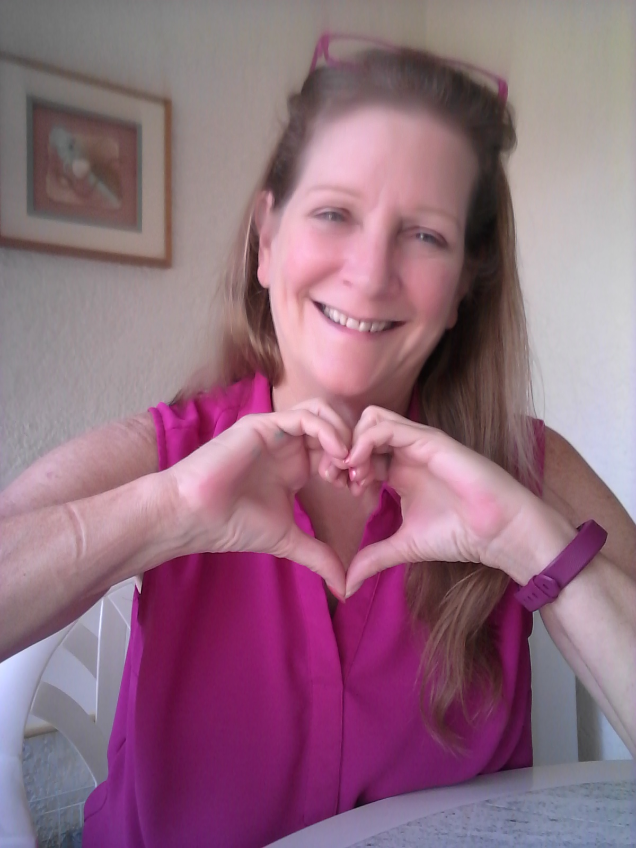
About Me…
Hello. I’m Linda Bergman (Ms. B.) I have been in the early childhood field since 1987 and in the classroom since 1995. I graduated with my Associates of Applied Science degree in Child Development from Muskingum Area Technical College in 2003 and am currently working to complete my Bachelor’s of Science in Human Services.
I have 2 adult children and 2 beautiful granddaughters. In my free time I like to walk the trails in the parks or visit the beach at sunset.
I am looking forward to a great year working with all of our families and students.

Slide 5
Student wellness expectations
English
Spanish
Each day parents will be asked to assess their child’s health before bringing them to school. Students with any of the following symptoms should not come to school:
Temperature above 100.4/chills
Vomiting or gastrointestinal issues
Chronic cough/shortness of breath
Loss of taste or smell
In general, if your child is not well, they should stay home
Been in close contact (15 minutes or more at less than 6 ft) with someone diagnosed with Covid-19 in the past 14 days
If a student exhibits any of these symptoms while at school they will receive care in a space away from other students and staff. A separate clinic space will be utilized for everyday student care. Parents will be called to pick up their child immediately.
Cada día se les pedirá a los padres que evalúen la salud de sus hijos antes de llevarlos a la escuela. Los estudiantes con alguno de los siguientes síntomas no deben asistir a la escuela:
Temperatura por encima de 100,4 / escalofríos
Vómitos o problemas gastrointestinales
Tos crónica / dificultad para respirar
Pérdida del gusto o el olfato
En general, si su hijo no se encuentra bien, debe quedarse en casa.
Ha estado en contacto cercano (15 minutos o más a menos de 6 pies) con alguien diagnosticado con Covid-19 en los últimos 14 días
Si un estudiante presenta alguno de estos síntomas mientras está en la escuela, recibirá atención en un espacio alejado de otros estudiantes y del personal. Se utilizará un espacio de clínica separado para el cuidado diario de los estudiantes. Se llamará a los padres para que recojan a sus hijos inmediatamente.

Slide 6
What can I expect my Scholar to learn this year…
Print knowledge (letters, book orientation/concepts, letters/words/meaning)
Phonological awareness (syllables, compound words, blend/dissect sounds/words)
Mathematics (counting, one to one correspondence, patterns, subitizing, number concepts)
Social/emotional skills
Basic science concepts (weather, body parts, magnets, building)
Dramatic play (pretend play through engaging “play” centers)

Slide 7
Our Daily Schedule
VPK Schedule
Arrival (Café DROP OFF OUTSIDE) 8:15-8:45am
Unpacking/Potty/Morning Work 8:50-9:15am
Recess 9:15-9:50am
Morning Circle 9:50-10:30am
Free Choice Centers 10:30-11:30am
Story Time/Literacy Circle 11:30-11:45am **½ Day Students Pack up & Leave (front gate) 11:45am**
Potty/Music and Movement 11:45-11:50am
PE 11:50-12:25pm
Potty/Transition 12:25-12:30pm
Lunch 12:30-1:00pm
Nap 1:00-2:30pm
Pack-up & head to dismissal line up 2:35-2:40pm
Dismissal (Café PICK UP OUTSIDE) 2:45pm

Slide 8
VPk Assessments
Assessments givens 3 times per year (September, February, May)
VPK Bright Beginnings Assessment- state required test given one on one; focus on print knowledge, phonological awareness, mathematics and oral language/vocab
GOLD Assessment- county required assessment that focuses on more than just academic base, but social/emotional development as well. Students are observationally assessed throughout the scoring period.
STAR Assessment- county required tablet assessment that is required in Kindergarten. This is now given to students in VPK to see progression in VPK knowledge in correlation to Kindergarten.

Slide 9
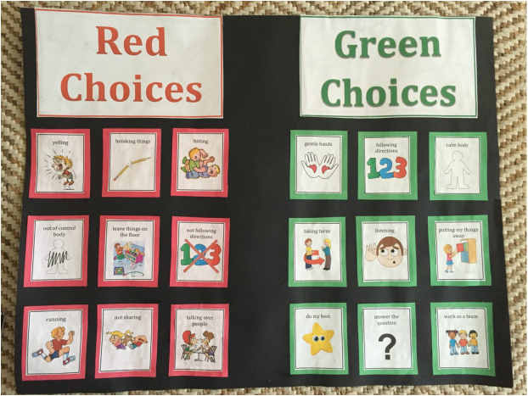
Classroom Expectations

Slide 10
Homework: Brain Builders
We send home Brain Builders homework every Mondays. Students are suggested to read at least one story per night and document on the brain builder homework. The homework is to be done each night, there is one activity to complete together with a parent/guardian. This is to be submitted on the following Monday morning. For every student that completes the homework and turns in, they will receive something from the treasure box!
Homework is completely optional as just to practice for Kindergarten and bring a home to school connection from our learning.

Slide 11
Center time
12 different centers that students rotate through the entire week; they get 15/20 minutes per center and then rotate to the next center. They are focused on the letter of the week and the thematic unit. These centers change every week and vary based on the learning goals.
Dramatic play- pretend play that is based on whatever theme we are working on
Tech/Computer- tablet used for independent learning, listening to stories or playing learning games
Literacy- center activities based on alphabet knowledge, letter of the week or specific skills
Mathematics- center activities based on thematic focus (patterns, number sense, sorting, etc.)
Sensory play- center based activities that appeal to the child’s senses and exploration (playdoh, water play, thematic focus, sand, etc.)
Large motor- center based activities that students can use their entire body to exercise certain muscles and skills (throwing, catching, tossing, bouncing, etc.)
Small motor- center based activities that focus on small motor and precise finger movements (sorting, tweezers, cutting, etc.)
Easel and Art- process based activities that the students follow multi-step directions to complete thematic/letter based art projects

Slide 12
How to reach us!
Class Dojo: please message us there first when trying to get ahold of us
Folders: you can write any notes in the folder and stick inside the sleeve so I see it daily when I write about the kiddos days
Email allenkay@pcsb.org or bergmanli@pcsb.org

